Slide 1
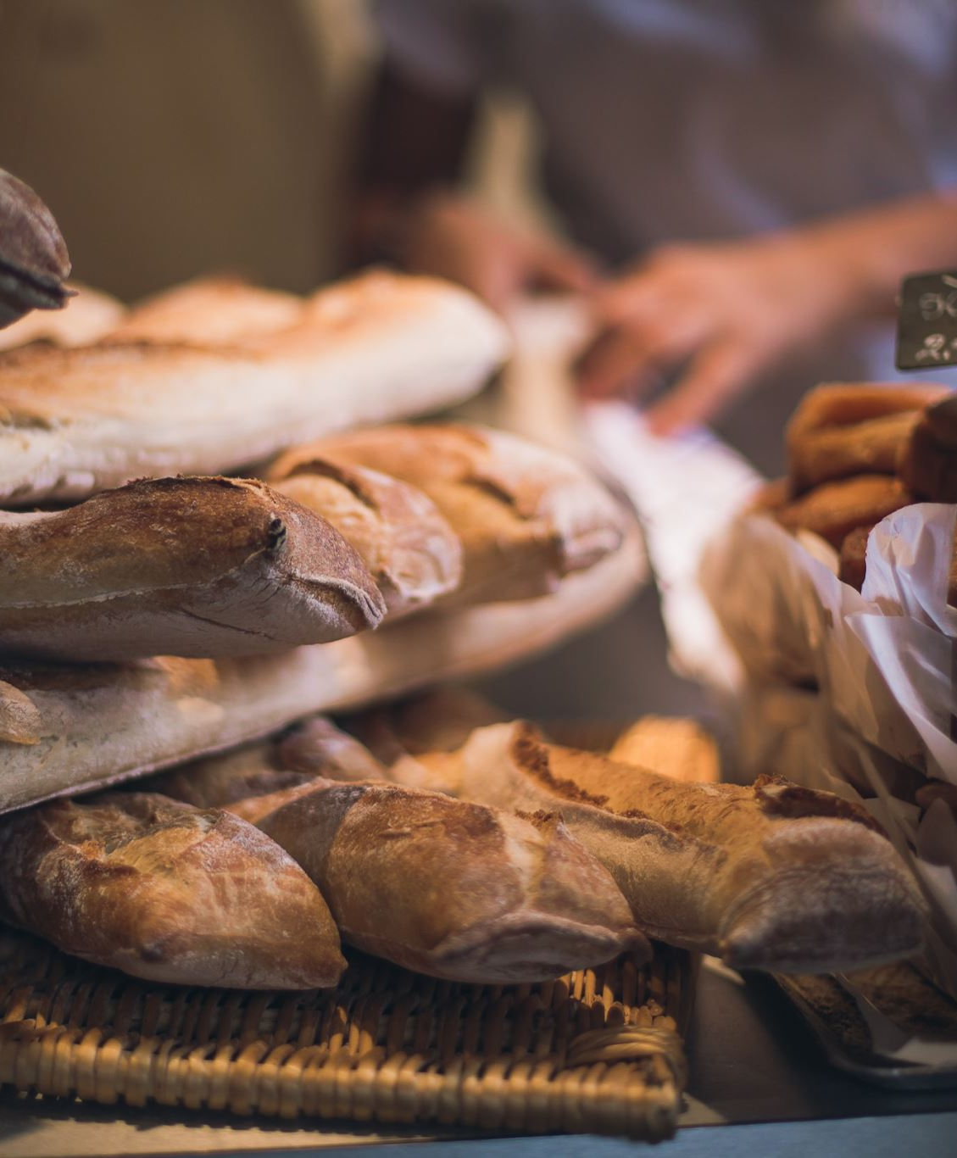
FOOD INSECURITY
GROUP 6
MICHAEL CICCHINO
VASILIY KONDRATYEV
BRENTON FENDER
EMORY SCOTT
WOYRAM ALMARANTE

Slide 2

TOPIC AND REASONING
Food Insecurity is defined as “a lack of consistent access to enough food for every person in a household to live an active, healthy life”. (USDA, 2023).
Based on the increasing rate of inflation following the COVID-19 Pandemic, how secure are household in the USA?
What are the factors that impact food insecurity?
Is there enough data to reveal trends and predict how access to food sources impact food insecurity.

Slide 3
DESCRIPTION OF DATA

Slide 4
DESCRIPTION OF DATA

Slide 5
DESCRIPTION OF DATA

Slide 6

RESEARCH QUESTION
Main Hypothesis:
How does physical access to food through restaurants, grocery stores and agriculture impact food insecurity?
Sub Hypotheses:
Does restaurant availability contribute to lowering food insecurity?
Which has a higher positive impact on food access: having more farmers markets or more general grocery stores?
How does agritourism influence food insecurity?
How do community supported farms verses regular farms have an impact on food insecurity?

Slide 7

DESCRIPTION OF DATA EXPLORATION PHASE
DESCRIPTION OF DATA EXPLORATION PHASE

Slide 8
DESCRIPTION OF DATA EXPLORATION PHASE
DESCRIPTION OF DATA EXPLORATION PHASE

Slide 9
DESCRIPTION OF ANALYSIS PHASE
DESCRIPTION OF ANALYSIS PHASE

Slide 10

THE TECHNOLOGIES, LANGUAGES, TOOLS AND ALGORITHMS THAT THE TEAM USED THROUGHOUT THE PROJECT
PYTHON- JUPYTER NOTEBOOK
ERD Generator- QuickDBD (quickdatabasediagrams.com)
PostgreSQL (pgAdmin)

Slide 11
REFERENCES
USDA, 2023
https://www.ers.usda.gov/webdocs/publications/45020/30967_err141.pdf
USDA ERS - Data Access and Documentation Downloads

